Slide 1
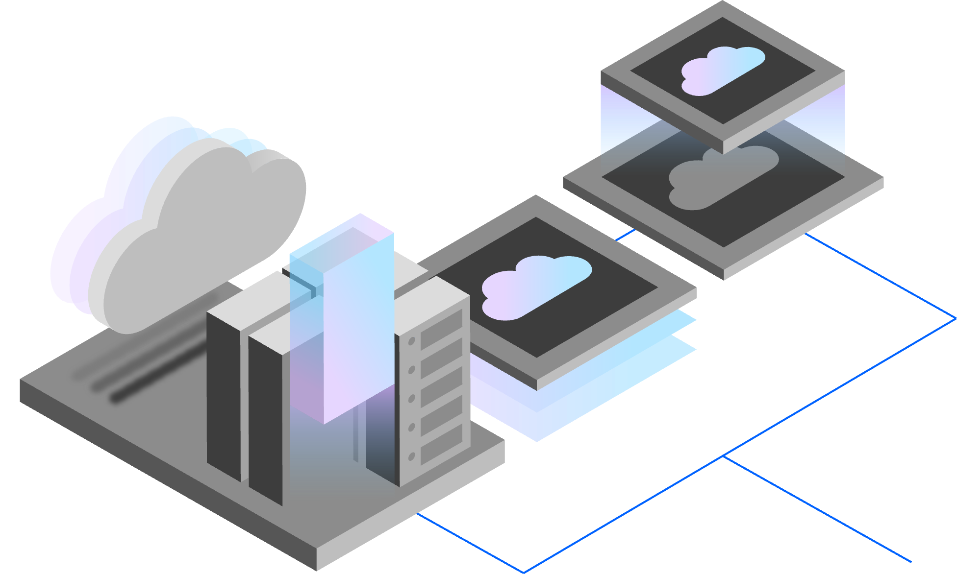
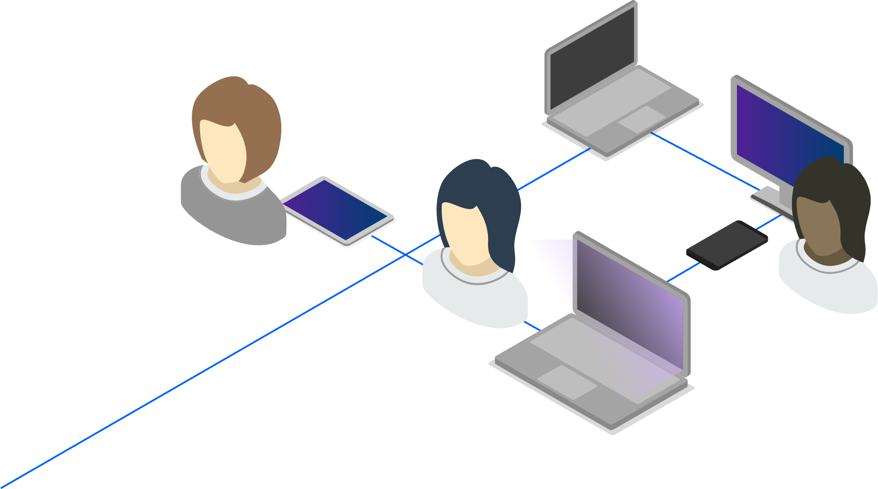

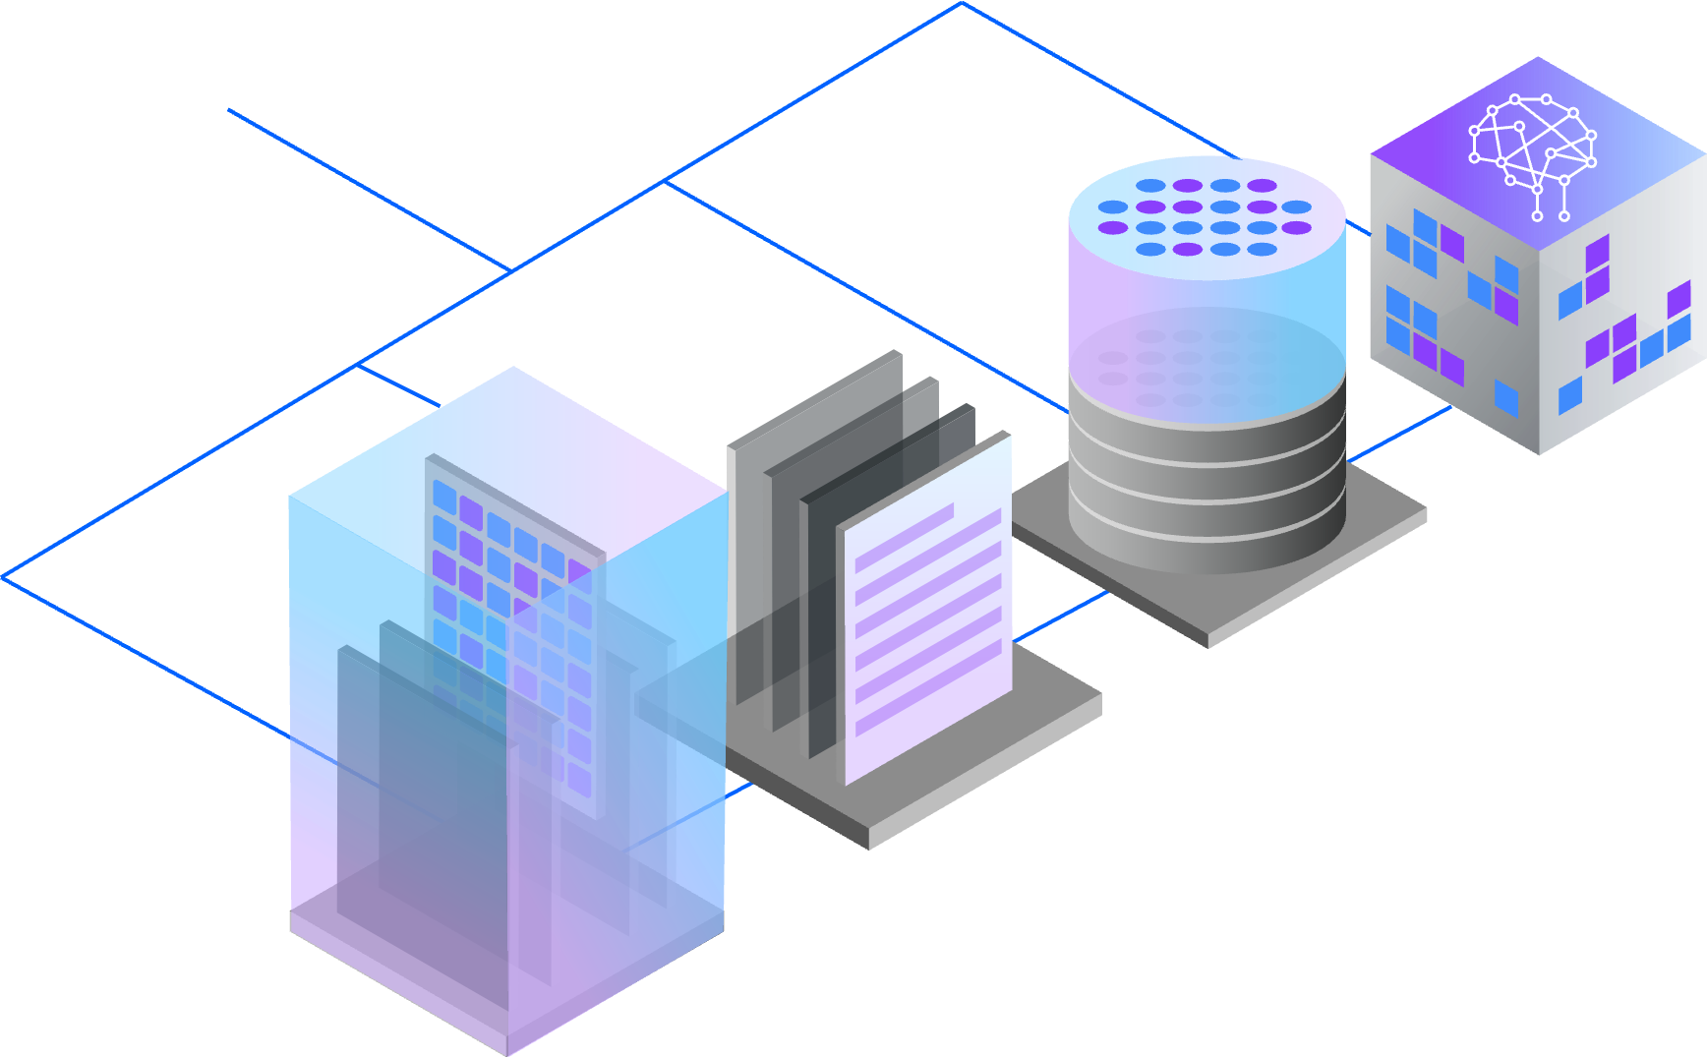
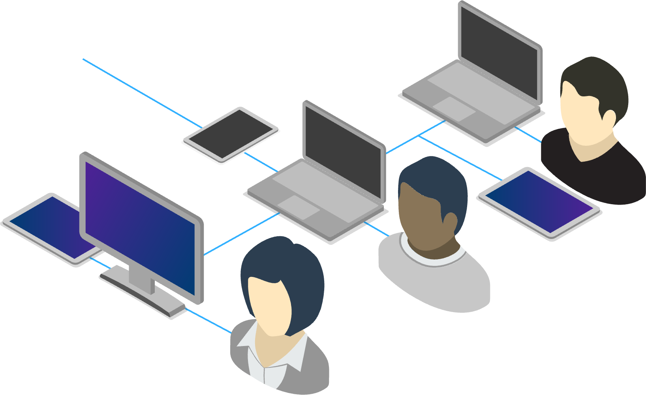
Lock it Down! IBM’s Key’s to Data Security Success
Melissa Gabriele Security Technical Specialist

Slide 2







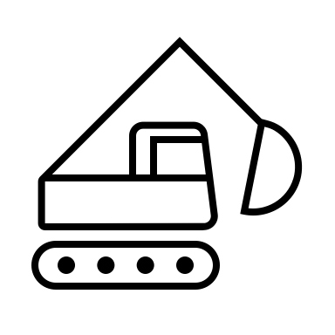

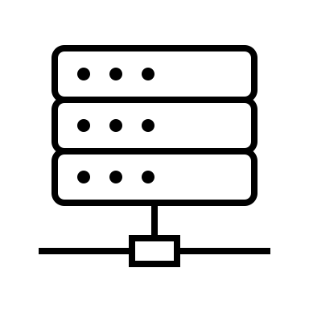


Data
30%
Avg cost of a data breach…
$4.88 million
Threat Actors
77% of data breaches started with stolen creds
Customers
DSPM
Users of Privilege
Data DR
Employees
82% of data breaches occurred via UoP
1. Visibility
70%
MTE/R
Avg 277 Days
2. Context
Third Parties
Governance
3. Accuracy
1. Active T.A
4. Movement - DR
2. Risk Scoring
5. Vulnerability Management
98% of breaches occurred in environments w/ known vulns
3. Real Time Trust Evaluator
Third Party
Data Security
Data
6. Identity Intelligence Insights
62% of UoP attacks were from Third Parties
Compliance & Auditing
Policies into Rules
89% reduction in auditing work
“Mask on the Glass”

Slide 3
Keys to Data Security Success
Visibility
With Context
Holistic Governance Controls
Proactive Response to Threats
IBM Security Guardium
Modernized to keep pace and stay secure as your data landscape evolves
Simplified compliance to quickly address security and privacy regulations
Smarter data threat response to improve data security outcomes

Slide 4
Thank you
Follow us on:
ibm.com/security
securityintelligence.com
ibm.com/security/community
xforce.ibmcloud.com
@ibmsecurity
youtube.com/ibmsecurity
© Copyright IBM Corporation 2024. All rights reserved. The information contained in these materials is provided for informational purposes only, and is provided AS IS without warranty, of any kind, express or implied. Any statement of direction represents IBM’s current intent, is subject to change or withdrawal, and represent only goals and objectives. IBM, the IBM logo, and other IBM products and services are trademarks of the International Business Machines Corporation, in the United States, other countries or both. Other company, product, or service names may be trademarks or service marks of others.
Statement of Good Security Practices: IT system security involves protecting systems and information through prevention, detection and response to improper access from within and outside your enterprise. Improper access can result in information being altered, destroyed, misappropriated or misused or can result in damage to or misuse of your systems, including for use in attacks on others. No IT system or product should be considered completely secure and no single product, service or security measure can be completely effective in preventing improper use or access. IBM systems, products and services are designed to be part of a lawful, comprehensive security approach, which will necessarily involve additional operational procedures, and may require other systems, products or services to be most effective. IBM does not warrant that any systems, products or services are immune from, or will make your enterprise immune from, the malicious or illegal conduct of any party.
Notes:
This slide requires no speaker notes.
NOTE: Proofreader’s query:
© Copyright IBM Corporation 2021. “Matches backup, but should date be updated?”
“Backup has speaker icon and IBM Security logo.”

Slide 5
Notes:
This slide requires no speaker notes.

